Slide 1
Service-Oriented Software Development
SE495: Software and Systems Integration

Slide 2
Outline
Introduction
Integration Types
Integration Models
Integrated system vs. Legacy System
Integration type
Integration Architecture

Slide 3
Service-Oriented Software Development

Slide 4
Overview of SOD Environments
ASP.NET Web Services (a.k.a. ASMX);
.NET Remoting;
Enterprise Services (the successor to COM+);
Web Services Enhancements (WSE);
Microsoft Message Queuing (MSMQ);
Windows Communication Foundation (WCF);
Java-based SOA Development: NetBeans, Eclipse/Axis/Tomcat
Google gRPC Service and Client
Oracle/JDeveloper (text chapter 8)
Websphere (IBM)
SCA/SDO (IBM and others)

Slide 5
SOD Frameworks for Service Development
Service Development Environment | Platform- independent Web service | Platform- dependent service | Distributed transactions | WS-* specification (e.g., reliability and security) | Primary language supported
ASMX / ASP .Net | X (obsolete) |  |  |  | C# / VB
.Net Remoting and Java Remoting |  | X |  |  | C# Java
Services: BizTalk |  |  | X |  | XLang / BPEL
WCF | X | X | X | X | C# / VB
AJAX | X |  |  |  | Java Script
Eclipse / Axis / Tomcat | X | X | X | X | Java
JEE: Java Enterprise Edition | X | X | X | X | Java / Java Script / JavaBeans
NetBeans | X | X | X | X | Java
VS AspNet.WebApi | X |  | X | X | C#
VS Google gRPC | X |  | X | X | C#

Slide 6
As a Service Provider
Develop Web Services Using
Visual Studio WCF
Java Platforms
Python Platforms
Google Platforms
Service brokers
Registry
Registry
WCF services: .svc WSDL/SOAP
WCF / Web API: RESTful
Application builder
Service providers
Different programming interfaces, with interface WSDL or Web API
Applications
Class / Object
Java-based services
Google gRPC Service (optional)

Slide 7



Developing New Web Services (.svc) in Windows Communication Foundation New Standard Recommended in .Net 4.x, replaces the first-generation .asmx services
WCF Service.svc
WCF Client
Endpoint
A
B
C
Proxy
Endpoint
A
B
C
A
B
C
Endpoint
HTTP/S and others
A
B
C
Address
(where)
Binding
(how)
Contract
(what)
Endpoint/Proxy

Slide 8
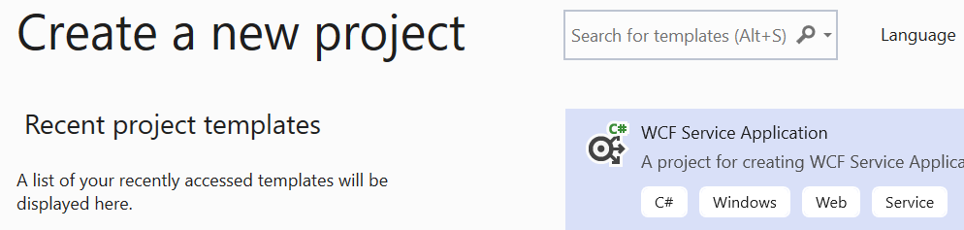
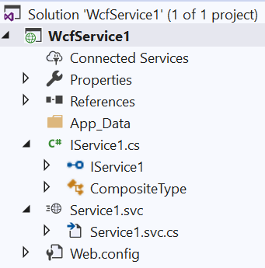
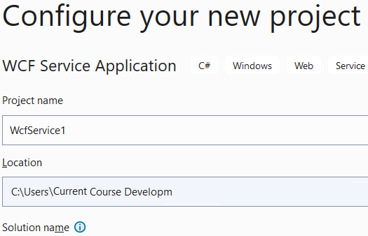
Develop Web Services Using WCF (VS 2022)

Slide 9
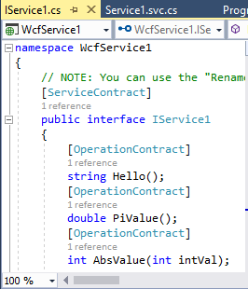
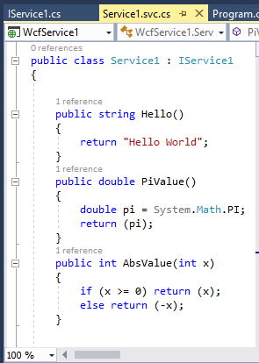
IService.cs and Service.cs Files
Ordinary class
Address
(where)
Binding
(how)
Contract
(what)
Endpoint/Proxy

Slide 10
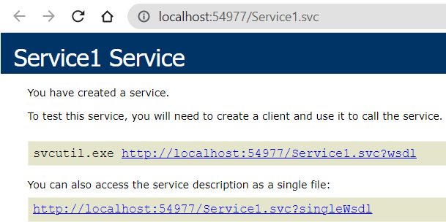
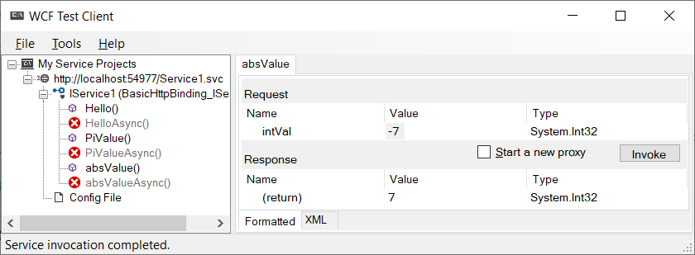
Viewing and Testing a .svc service
(1) In Visual Studio, right click service file “Service1.svc” and choose: View in Browser
(2) In Visual Studio, Menu: Debug → Start Without Debugging

Slide 11
WSDL: Web Service Description Language
WSDL is an industry-wide standard backed by MS, IBM, Oracle, AWS, …
WSDL is used for describing Web services, including four critical aspects of Web services:
Functionality description of services in standard taxonomy;
Contract of parameter types and return type of the function (service) calls;
Binding information about the transport protocol to be used, usually, SOAP;
Address information for locating the specified service.
The last three aspects can be automatically generated.
Web services described in WSDL can be searched, matched with the requirement.
Web services described in WSDL provides the remote call detail.

Slide 12
Logical Structure of WSDL Document’s Elements
definitions, with a name and namespaces used
A namespace of classes
A class
service
service
Address
port
(URL)
endpoints
port
(URL)
Binding
. . .
Multiple methods
binding
(soap)
binding
(soap)
Method name of the class
portType
portType
operation
operation
Method parameter types
Contract
message, in
. . .
message, in
types
types
Method return type
message, out
message, out
types
types

Slide 13
WSDL Example: Get Stock Quote
The example shows the WSDL definition of a simple service providing stock quotes.
The service supports a single operation called GetLastTradePrice, which is deployed using the SOAP protocol over HTTP.
The request takes a string (type) as input, and returns the price as a float (type).
http://www.w3.org/TR/wsdl

Slide 14
WSDL Example: Organization of the Code
definitions
<?xml version="1.0"?>
<definitions name="StockQuote"
(namespaces used)
<types> ... </types>
<messages> … </messages>
<portType>
<operation> … </operation>
</portType>
<binding> … </binding>
<service>
<port> … </port>
</service>
</definitions>
service
Port
(URL)
. . .
Binding
(soap)
PortType
Operation
Message, in
Types
Message, out
Types

Slide 15
WSDL Code Example (Namespaces)
Namespaces link to external definitions
Root node
Declare Namespaces and qualifiers
<?xml version="1.0"?>
<definitions name="StockQuote" targetNamespace="http://example.com/stockquote.wsdl"
xmlns:tns="http://example.com/stockquote.wsdl"
xmlns:xsd1="http://example.com/stockquote.xsd"
xmlns:soap="http://schemas.xmlsoap.org/wsdl/soap/"
xmlns="http://schemas.xmlsoap.org/wsdl/">
<types>
...
</types>
Put types definition in a separate page
Or, the types could be defined here
Qualifiers to define the scope

Slide 16
WSDL Code Example (TypeDef)
The types are defined in "http://example.com/stockquote.xsd"
<types>
<schema targetNamespace="http://example.com/stockquote.xsd"
xmlns="http://www.w3.org/2000/10/XMLSchema">
<element name="TradePriceRequest">
<complexType>
<all> <element name="tickerSymbol" type="string"/> </all>
</complexType>
</element>
<element name="TradePrice">
<complexType>
<all> <element name="price" type="float"/></all>
</complexType>
</element>
</schema>
</types>
①
②
Typedef in C/C++
typedef TradePriceRequest string;
typedef TradePrice float;

Slide 17
WSDL Code Example (message & portType)
<message name="GetLastTradePriceInput">
<part name=“body”
element="xsd1:TradePriceRequest"/>
</message>
<message name="GetLastTradePriceOutput">
<part name=“body” element="xsd1:TradePrice"/>
</message>
<portType name="StockQuotePortType">
<operation name="GetLastTradePrice">
<input message="tns:GetLastTradePriceInput"/>
<output message="tns:GetLastTradePriceOutput"/>
</operation>
</portType>
①
②
Use type to define variables
Address
(where)
Binding
(how)
Contract
(what)

Slide 18
WSDL Code Example (binding via soap)
<binding name=“StockQuoteSoapBinding” type="tns:StockQuotePortType">
<soap:binding style="document"
transport= "http://schemas.xmlsoap.org/soap/http"/>
<operation name="GetLastTradePrice">
<soap:operation soapAction=
"http://example.com/GetLastTradePrice"/>
<input> <soap:body use="literal"/></input>
<output> <soap:body use="literal"/></output>
</operation>
</binding>
Address
(where)
Binding
(how)
Contract
(what)

Slide 19
WSDL Code Example (service & port)
<service name="StockQuoteService">
<documentation>
This service offers latest stock quotes
</documentation>
<port name="StockQuotePort" binding= "tns:StockQuoteBinding">
<soap:address location= "http://example.com/stockquote"/>
</port>
</service>
</definitions>
Address
(where)
Binding
(how)
Contract
(what)

Slide 20
Names of Elements
definitions: name="StockQuote“, namespaces
service: name="StockQuoteService">
port
name="StockQuotePort"
binding
name=“StockQuoteSoapBinding” <binding style="document"/> …
portType: name=“StockQuotePortType”
operation: name=“GetLastTradePrice”
message: name=“GetLastTradePriceInput”>
types: TradePriceRequest
message, name="GetLastTradePriceOutput">
types: TradePrice

Slide 21
Abstraction and Flexibility of Elements
definitions
port and portType definitions are abstract; binding/operation will be used to specify a concrete protocol/operation. This allows
separating definitions from their implementation details regarding network deployment or bindings;
the reuse of the definitions in different apps.
message definition is abstract: abstract descriptions of the data being exchanged; types are used to associate specific data types to the messages. This allows
messages are separated from their implementation detail of data format;
the reuse of message definition;
wrap multiple parameters in the message
service
port
(URL)
. . .
binding
(soap)
portType
operation
message, in
types
message, out
types

Slide 22
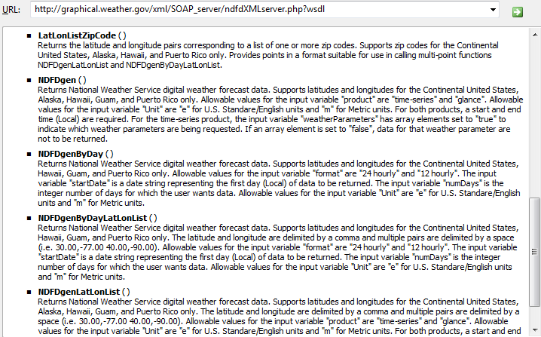
U.S. National Weather Forecast Service
http://graphical.weather.gov/xml/SOAP_server/ndfdXMLserver.php?wsdl
zipcode1, …, zipcoden → (lat1, lon1), …, (latn, lonn)

Slide 23
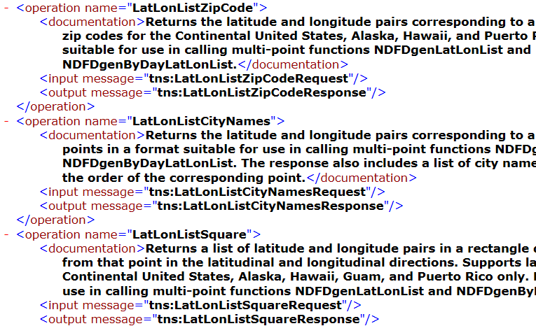
http://graphical.weather.gov/xml/SOAP_server/ndfdXMLserver.php?wsdl

Slide 24
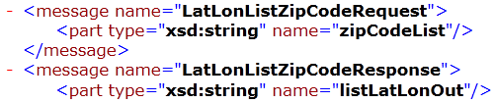
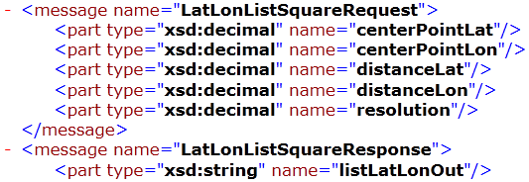
Type Definition of the Operations
More detail of the service and its operations are at:
http://graphical.weather.gov/xml/
http://graphical.weather.gov/xml/SOAP_server/ndfdXMLserver.php

Slide 25
From WSDL/SOAP to RESTful Services
Use
WSDL / SOAP / HTTP
WSDL services
SOAP Services
WSDL/SOAP services
.asmx services
.svc services
RESTful Services
Web APIs
Services
Use HTTP Only

Slide 26
Developing RESTful Services
Services
Use HTTP Only
RESTful Services
There are different ways of developing RESTful services. We show two ways here:
(1) Convert a WSDL/SOAP service into a RESTful service using WCF.
(2) Develop RESTful service without first developing WSDL service

Slide 27
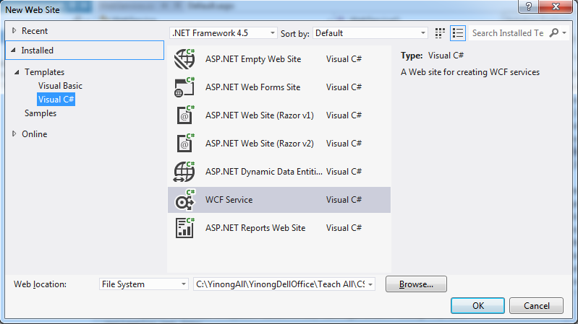
Developing a RESTful Service Using WCF
In Visual Studio menu, choose New Web Site
Choose C# template, and choose “WCF Service”.
Name the project WcfRestService3.

Slide 28
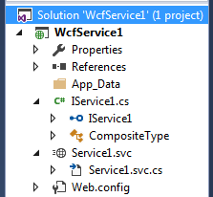
Developing WCF Service First
The template creates standard WCF service files, including
IService1.cs interface
Service1.svc.cs file
Service1.svc file
Web.config file
1
2
3

Slide 29
Add HTTP method: [WebGet] in IService.cs:
using System;
using System.ServiceModel;
using System.ServiceModel.Web;
[ServiceContract]
public interface Iservice {
[OperationContract]
[WebGet] // Add this HTTP GET attribute/directive, use default format
double PiValue();
[OperationContract]
[WebGet(UriTemplate = “AbsValue?x={x}”)] // define input format
int AbsValue(int x);
[OperationContract]
[WebGet(UriTemplate = “add2?x={x}&y={y}”)] // define input format
int addition(int x, int y);
}
1
1
One argument method: this UriTemplate is implied
Two-argument method: a UriTemplate is required

Slide 30
Service.cs (No change to implementation)
using System;
public class Service : IService {
public double PiValue() {
double pi = System.Math.PI;
return (pi);
}
public int AbsValue(int x) {
if (x >= 0) return (x);
else return (-x);
}
public int addition(int x, int y) {
return (x + y);
}
}

Slide 31
Modify Service1.svc Markup File
Right-click Service.svc and choose “View Markup” add one line of code, which adds RESTful service hosting model:
<%@ ServiceHost Language="C#" Debug="true" Service="Service" CodeBehind="~/App_Code/Service.cs" %>
Existing code
<%@ ServiceHost Language="C#" Debug="true" Service="WcfService1.Service1" CodeBehind="Service1.svc.cs"
Factory="System.ServiceModel.Activation.WebServiceHostFactory" %>
2
Right-click

Slide 32
Remove SOAP Endpoint in Web.config
3
In the Web.config file, remove the entire <system.serviceModel> element, which will remove the SOAP endpoints.
RESTful services do not support the SOAP-endpoint-based access.
Removing this element will immediately disable the accesses from service proxies of all kinds of SOAP clients.
Open this file

Slide 33
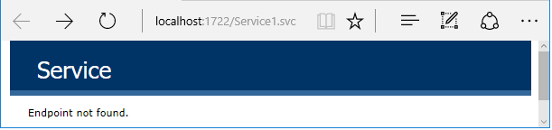
Accessing the Service over HTTP in a Browser
View the Service in Browser
http://localhost:1722/Service1.svc/PiValue it returns: <double>3.1415926535897931</double>
http://localhost:1722/Service1.svc/AbsValue?x=-27, it returns: <int>27</int>
http://localhost:1722/Service1.svc/add2?x=15&y=17 → it returns: 32
Test the Deployed RESTful services in ASU Repository: PiValue, AbsValue, and add2 operations
http://venus.sod.asu.edu/WSRepository/Services/WcfRestService4/Service1/ http://venus.sod.asu.edu/WSRepository/Services/WcfRestService4/Service1/PiValue http://venus.sod.asu.edu/WSRepository/Services/WcfRestService4/Service1/AbsValue?x=-123 http://venus.sod.asu.edu/WSRepository/Services/WcfRestService4/Service1/add2?x=15&y=17

Slide 34
Accessing RESTful Service in a Program
Knowing the format of accessing the service
http://venus.sod.asu.edu/WSRepository/Services/RandomString/Service.svc/ GetRandomString/8
Construct the URL in the program
Base URL
Operation name
Parameters
Convert the return data to the required type
baseURL
Operation name
Parameter vale

Slide 35
Creating RESTful Web APIs without First Creating WSDL services and without using WCF
A Case Study

Slide 36
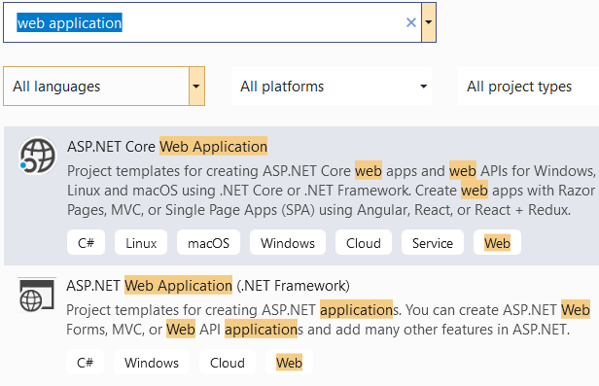
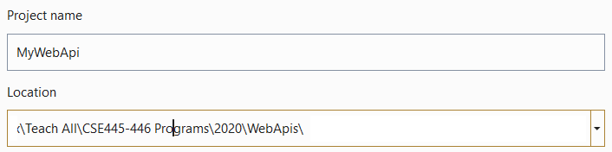

Creating RESTful Web APIs without WCF
https://www.tutorialsteacher.com/webapi/create-web-api-project
Step 1:
Choose
right template:
Step 2:
Step 3:

Slide 37
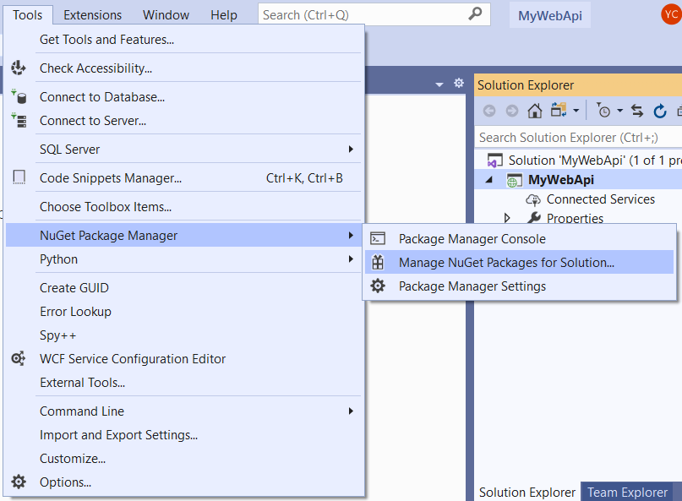
Tools → NuGet Package Manager

Slide 38
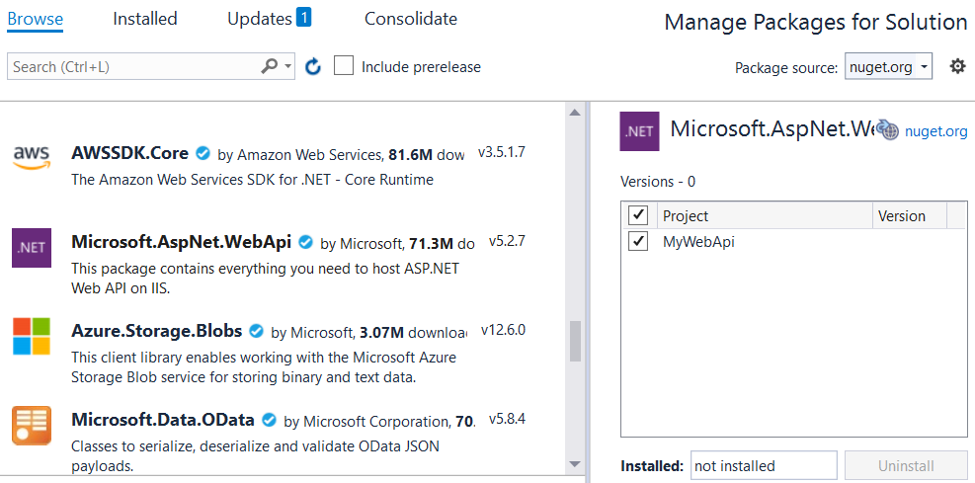

Browse to Install Microsoft.AspNet.WebApi

Slide 39
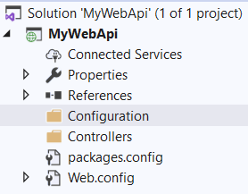
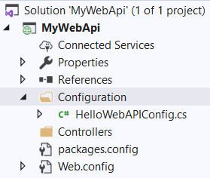
Add Controllers and Configuration folders
Right click project name and add two New Folders into the project
Right click Configuration folder and add a class HelloWebAPIConfig
MVC Architecture Pattern, more in CSE446/598
Configuration folder holds a class for registering and configuring the service
Controller folder holds a class that implement the service

Slide 40
Copy the code into HelloWebAPIConfig class
using System;
using System.Web.Http;
namespace HelloWebAPI.Configuration
{
public static class HelloWebAPIConfig
{
public static void Register(HttpConfiguration config)
{
config.MapHttpAttributeRoutes(); // Web API routes
config.Routes.MapHttpRoute(
name: "DefaultApi",
routeTemplate: "api/{controller}/{id}",
defaults: new { id = RouteParameter.Optional }
);
}
}
}

Slide 41
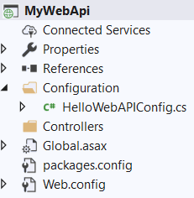
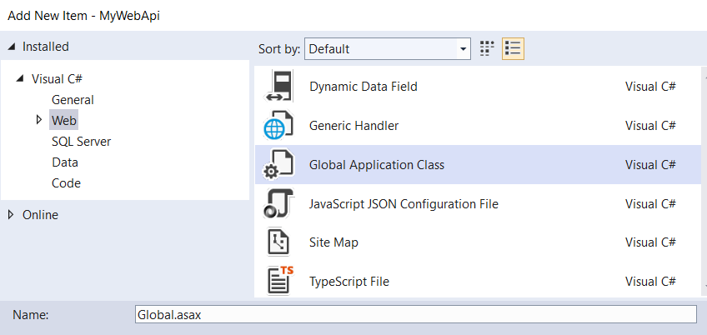
Add Global.asax
Right clicking project name -> Add → New Item → Global Application Class
Name it: Global.asax

Slide 42
Copy this code into Global.asax file
using System;
using System.Web.Http;
using HelloWebAPI.Configuration;
namespace MyWebApi
{
public class Global : System.Web.HttpApplication
{
protected void Application_Start(object sender, EventArgs e)
{
GlobalConfiguration.Configure(HelloWebAPIConfig.Register);
}
}
}
Application_Start event handler: When the application starts, it runs the code to register the api.

Slide 43

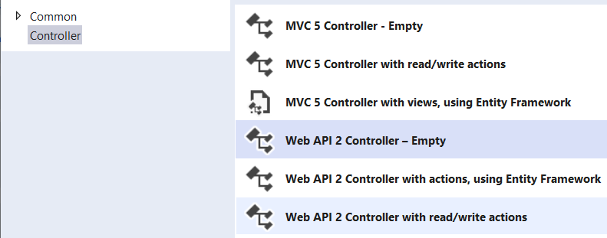
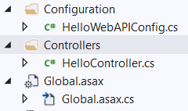
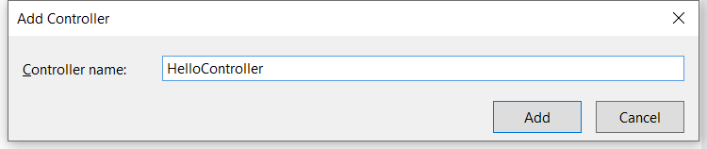
Add Controller
Right click Add and choose Controller …

Slide 44
Copy the code into HelloController.cs
using System;
using System.Web.Http;
namespace MyWebApi.Controllers
{
public class HelloController : ApiController
{
public string Get()
{
return "Hello World";
}
}
}
You can add any service code here

Slide 45
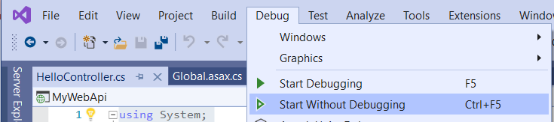
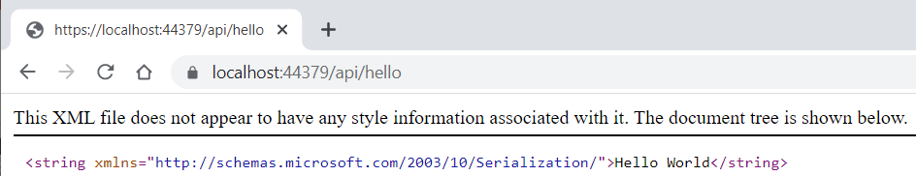
Build and then Start
The browser will start at the address: https://localhost:44379/ → HTTP Error 403.14 - Forbidden
You type the full address into your web browser: https://localhost:44379/api/hello
Deployed to venus server:
http://venus.sod.asu.edu/WSRepository/Webapis/HelloWebApi/api/hello

Slide 46
Accessing REST service URL in program For more detail read: Text chapter 7.3 on RESTful Services
Notice how a RESTful service is access here
public string GetRandomString(string myLength) {
// Create the base address to the RandomString service
Uri baseUri = new Uri("http://venus.sod.asu.edu/WSRepository/Services/RandomString/Service.svc");
// Define UriTemplate for passing parameter
UriTemplate myTemplate = new UriTemplate("GetRandomString/{Length}");
// Assign values to variable to obtain the complete URI
Uri completeUri = myTemplate.BindByPosition(baseUri, myLength);
WebClient channel = new WebClient(); // create a channel
byte[] abc = channel.DownloadData(completeUri); // return byte array
Stream strm = new MemoryStream(abc); // convert to mem stream
DataContractSerializer obj = new DataContractSerializer(typeof(string));
string randString = obj.ReadObject(strm).ToString(); // convent to string
return randString;
}

Slide 47
Additional Method not Required
A reference to new method of service development

Slide 48
Creating Google gRPC Service and Client in Visual Studio Core
Create a gRPC Server.
Create a gRPC client.
Test the gRPC client service with the gRPC Greeter service.
Please read the following slides together with this tutorial:
https://docs.microsoft.com/en-us/aspnet/core/tutorials/grpc/grpc-start?view=aspnetcore-5.0&tabs=visual-studio

Slide 49
Cloud Endpoints for gRPC
https://cloud.google.com/endpoints/docs/grpc/about-grpc
gRPC is a high performance, open-source universal RPC framework, developed by Google.
In gRPC, a client application can directly call methods on a server application on a different machine as if it was a local object, making it easier to create distributed applications and services.
gRPC exposes endpoints to the outside to enable different types of clients.
gRPC client
HTTP / JSON clients
We show an example of using Visual Studio to develop a gRPC service and client
https://www.grpc.io/docs/

Slide 50
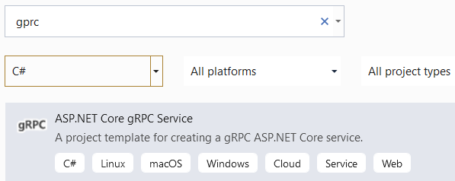
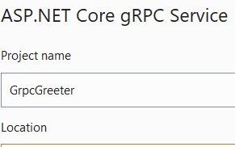
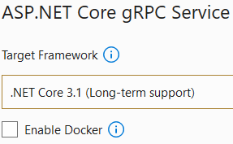
Creating gRPC Service
https://docs.microsoft.com/en-us/aspnet/core/tutorials/grpc/grpc-start?view=aspnetcore-5.0&tabs=visual-studio
Start Visual Studio and select Create a new project.
In the Create a new project dialog, select gRPC Service and select Next

Slide 51
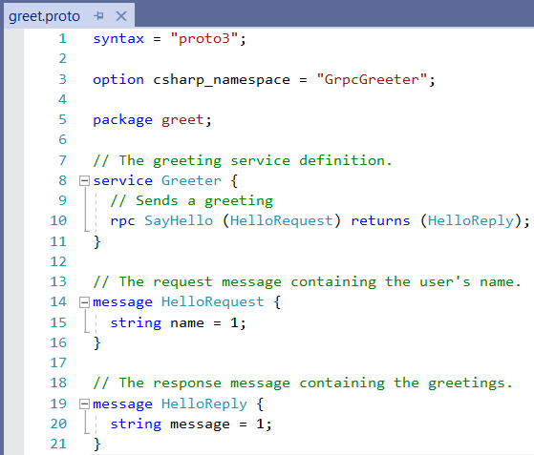
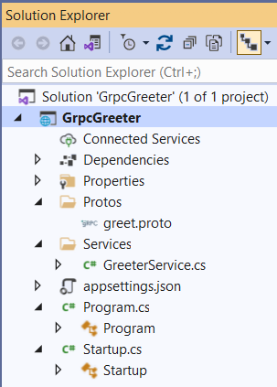
gRPC Service Project is Created

Slide 52
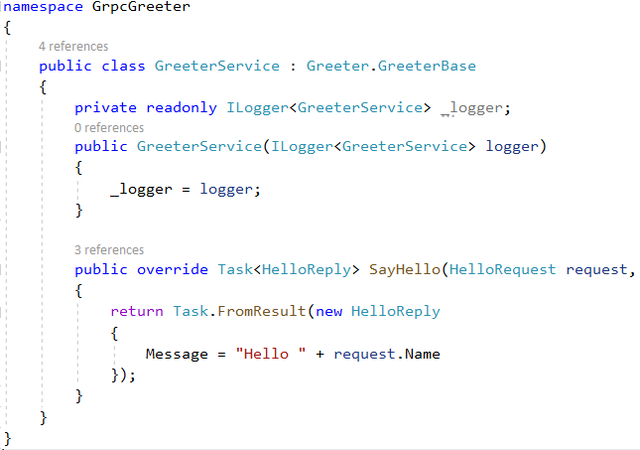
gRPC Service Code

Slide 53
Start the gRPC service at https://localhost:5001
Press Ctrl+F5 to run without the debugger.
Visual Studio displays a dialog for configuring to use SSL.
Click Yes.
A Security Waring dialog for installing security certificate
Click Yes.
Then, Visual Studio will run the service in IIS Express. The information will be displayed in Console window, showing
Now listening on: https://localhost:5001

Slide 54
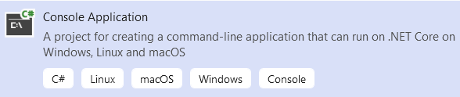
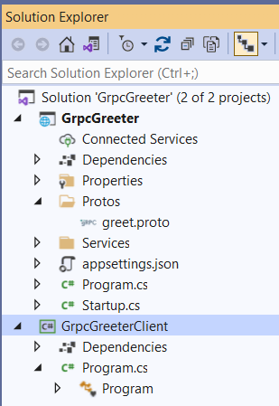
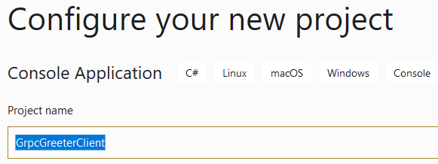
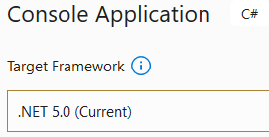
Create Client
Right click Solution and choose to add a New Project
Name the Project: GrpcGreeterClient

Slide 55
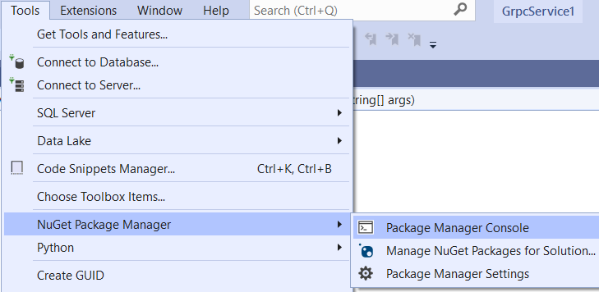
Add Required Packages to Client Project
In Visual Studio Menu, Select:
Tools → NuGet Package Manager → Package Manager Console

Slide 56
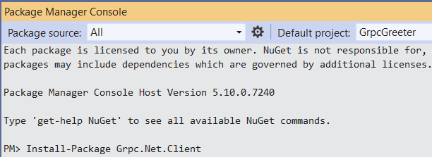
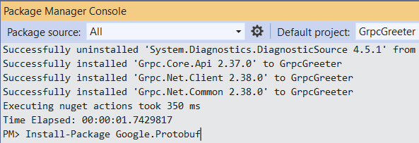
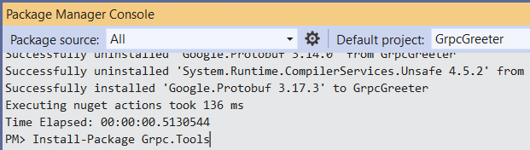
Install Three Packages by Commands:
At the lower window in Visual Studio:
Install-Package Grpc.Net.Client
Install-Package Google.Protobuf
Install-Package Grpc.Tools

Slide 57
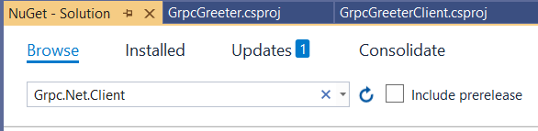
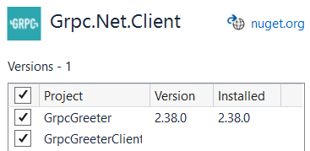
Another Way of Installing NuGet Packages
Manage NuGet Packages option to install packages
Right-click the project in Solution Explorer > Manage NuGet Packages
Select Browse tab and enter Grpc.Net.Client in the search box
Select the Grpc.Net.Client package and select Install.
Repeat for Google.Protobuf and Grpc.Tools.

Slide 58
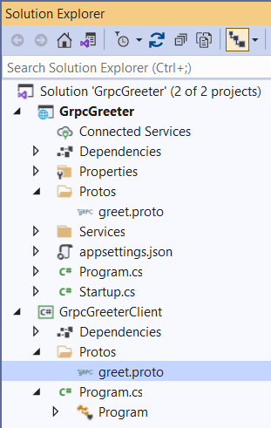
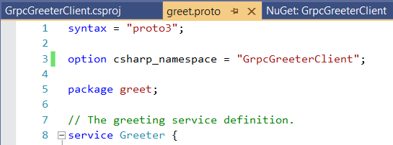
Create Client
Create a Protos folder in the gRPC client project
Copy the Protos\greet.proto file from the gRPC Greeter service to the gRPC client project.
In the Client project, update the namespace inside the greet.proto file to the project's namespace:
option csharp_namespace = "GrpcGreeterClient";

Slide 59
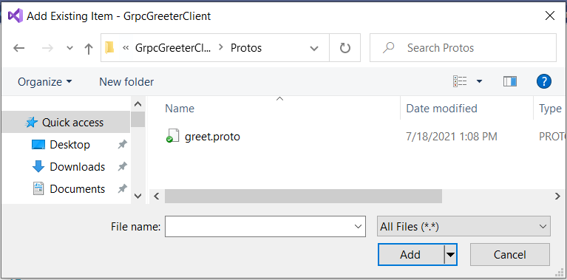
Add greet.proto file
Even though greet.proto file is added into the client folder Protos, the file is not linked to the project.
Right click the folder choose “Add” → Existing Item …

Slide 60
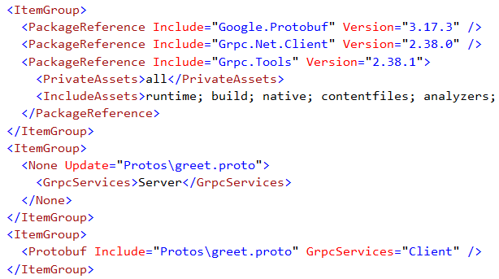
Edit the GrpcGreeterClient.csproj project file
Right-click Client project and select Edit Project File.
Add / or change the new <ItemGroup> element:
<ItemGroup>
<Protobuf Include="Protos\greet.proto" GrpcServices="Client" />
</ItemGroup>

Slide 61
Write the Greeter client code
using System;
using System.Net.Http;
using System.Threading.Tasks;
using Grpc.Net.Client;
namespace GrpcGreeterClient
{
class Program
{
static async Task Main(string[] args)
{
// The port number(5001) must match the port of the gRPC server.
using var channel = GrpcChannel.ForAddress("https://localhost:5001");
var client = new Greeter.GreeterClient(channel);
var reply = await client.SayHelloAsync(
new HelloRequest { Name = "GreeterClient" });
Console.WriteLine("Greeting: " + reply.Message);
Console.WriteLine("Press any key to exit...");
Console.ReadKey();
}
}
}

Slide 62
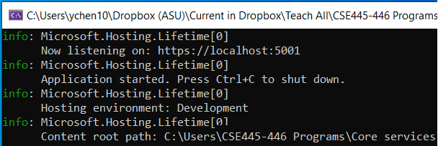

Test Service and Client on Localhost
Right click service project and choose “Set as Startup Project”
Start Without Debugging
Right click client project and choose “Set as Startup Project”
Start Without Debugging

